Slide 1
Exploratory Data Analysis
Data for exploration: 12 out of 70 questions
1. Years of work experience | 2. Work satisfaction rate
3. Expected salary | 4. Happiness
5. Height | 6. Weight
7. Age | 8. Number of Countries visited
9. Average sleep hours | 10. Like chocolate
11. Hours of reading extracurricular books per week | 12. Cups of coffee per week
Notes:
After cleaning the data, next step is doing data exploration.
Why do we filter the data (focus on only 12 instead of 70)?
Dataset contains 70 questions which are too many and some are very random / not interesting.
Questions that we think are interesting? Why?
They are mix of questions regarding general information like background and hobby without going into more specific details.

Slide 2
Approach
Summarise the data
Cluster the data: Hierarchical clustering
Find correlation between each question
Estimate density
Plot each pair of questions & draw regression line
Notes:
How do we explore and analyse the data?

Slide 3
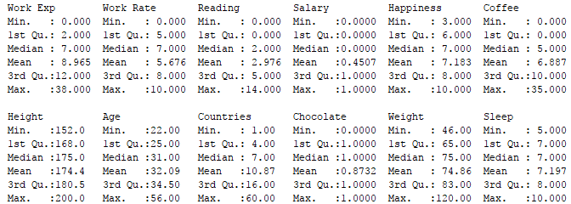
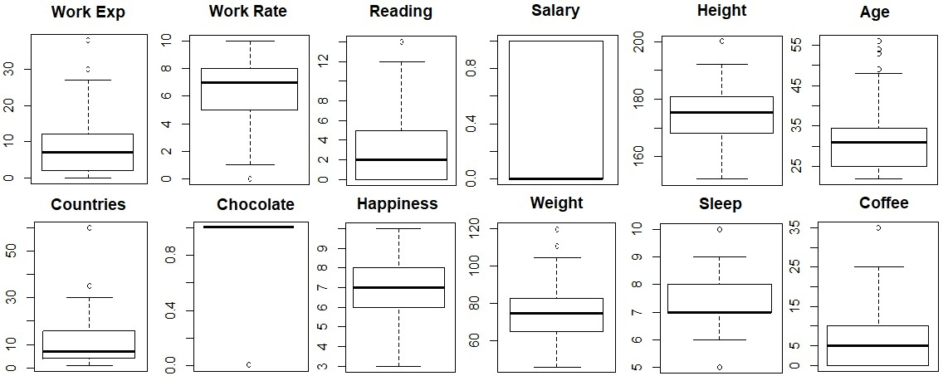
Summarise the Data
Notes:
Work Rate: 0 – 10
Salary: 0: <200k, 1: >= 200k
Chocolate: 1: Y, 0: N
Happiness: 1 – 10

Slide 4
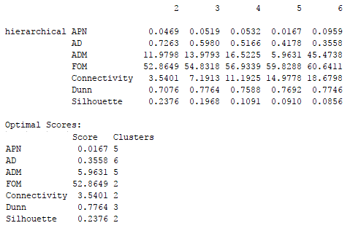
Cluster the Data
Hierarchical Clustering using correlation as a distance measure.
Find the optimal cluster size.
Notes:
Why do we use hierarchical clustering and correlation?
To group the attributes (questions).
Optimal cluster: 2 & 5.

Slide 5
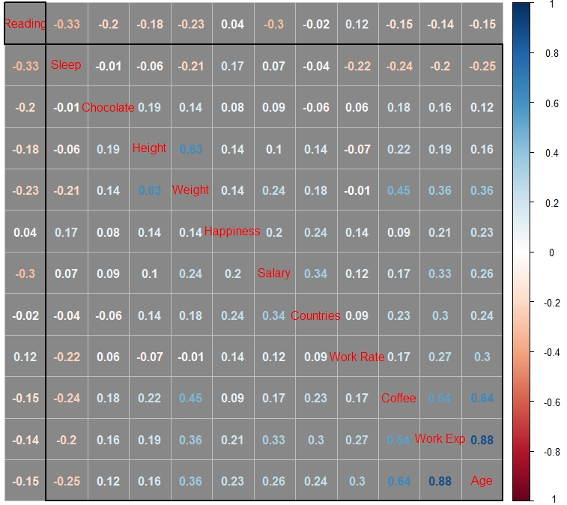
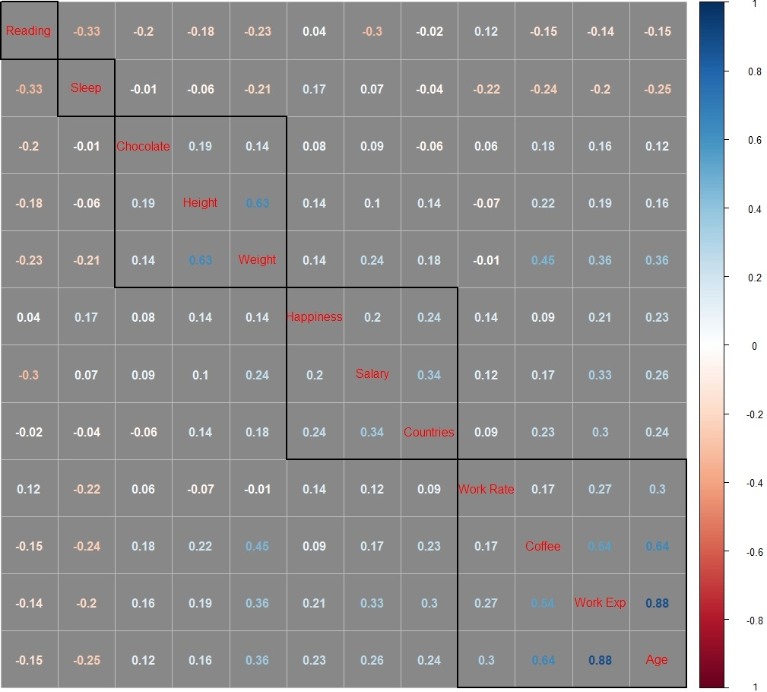
Find Correlation
Use correlation matrix.
2 Clusters 5 Clusters
Notes:
Clustering is used to sort and group the questions.
Try 2 & 5 clusters which are based on optimal scores of cluster validation.
Each black square represents 1 cluster.

Slide 6
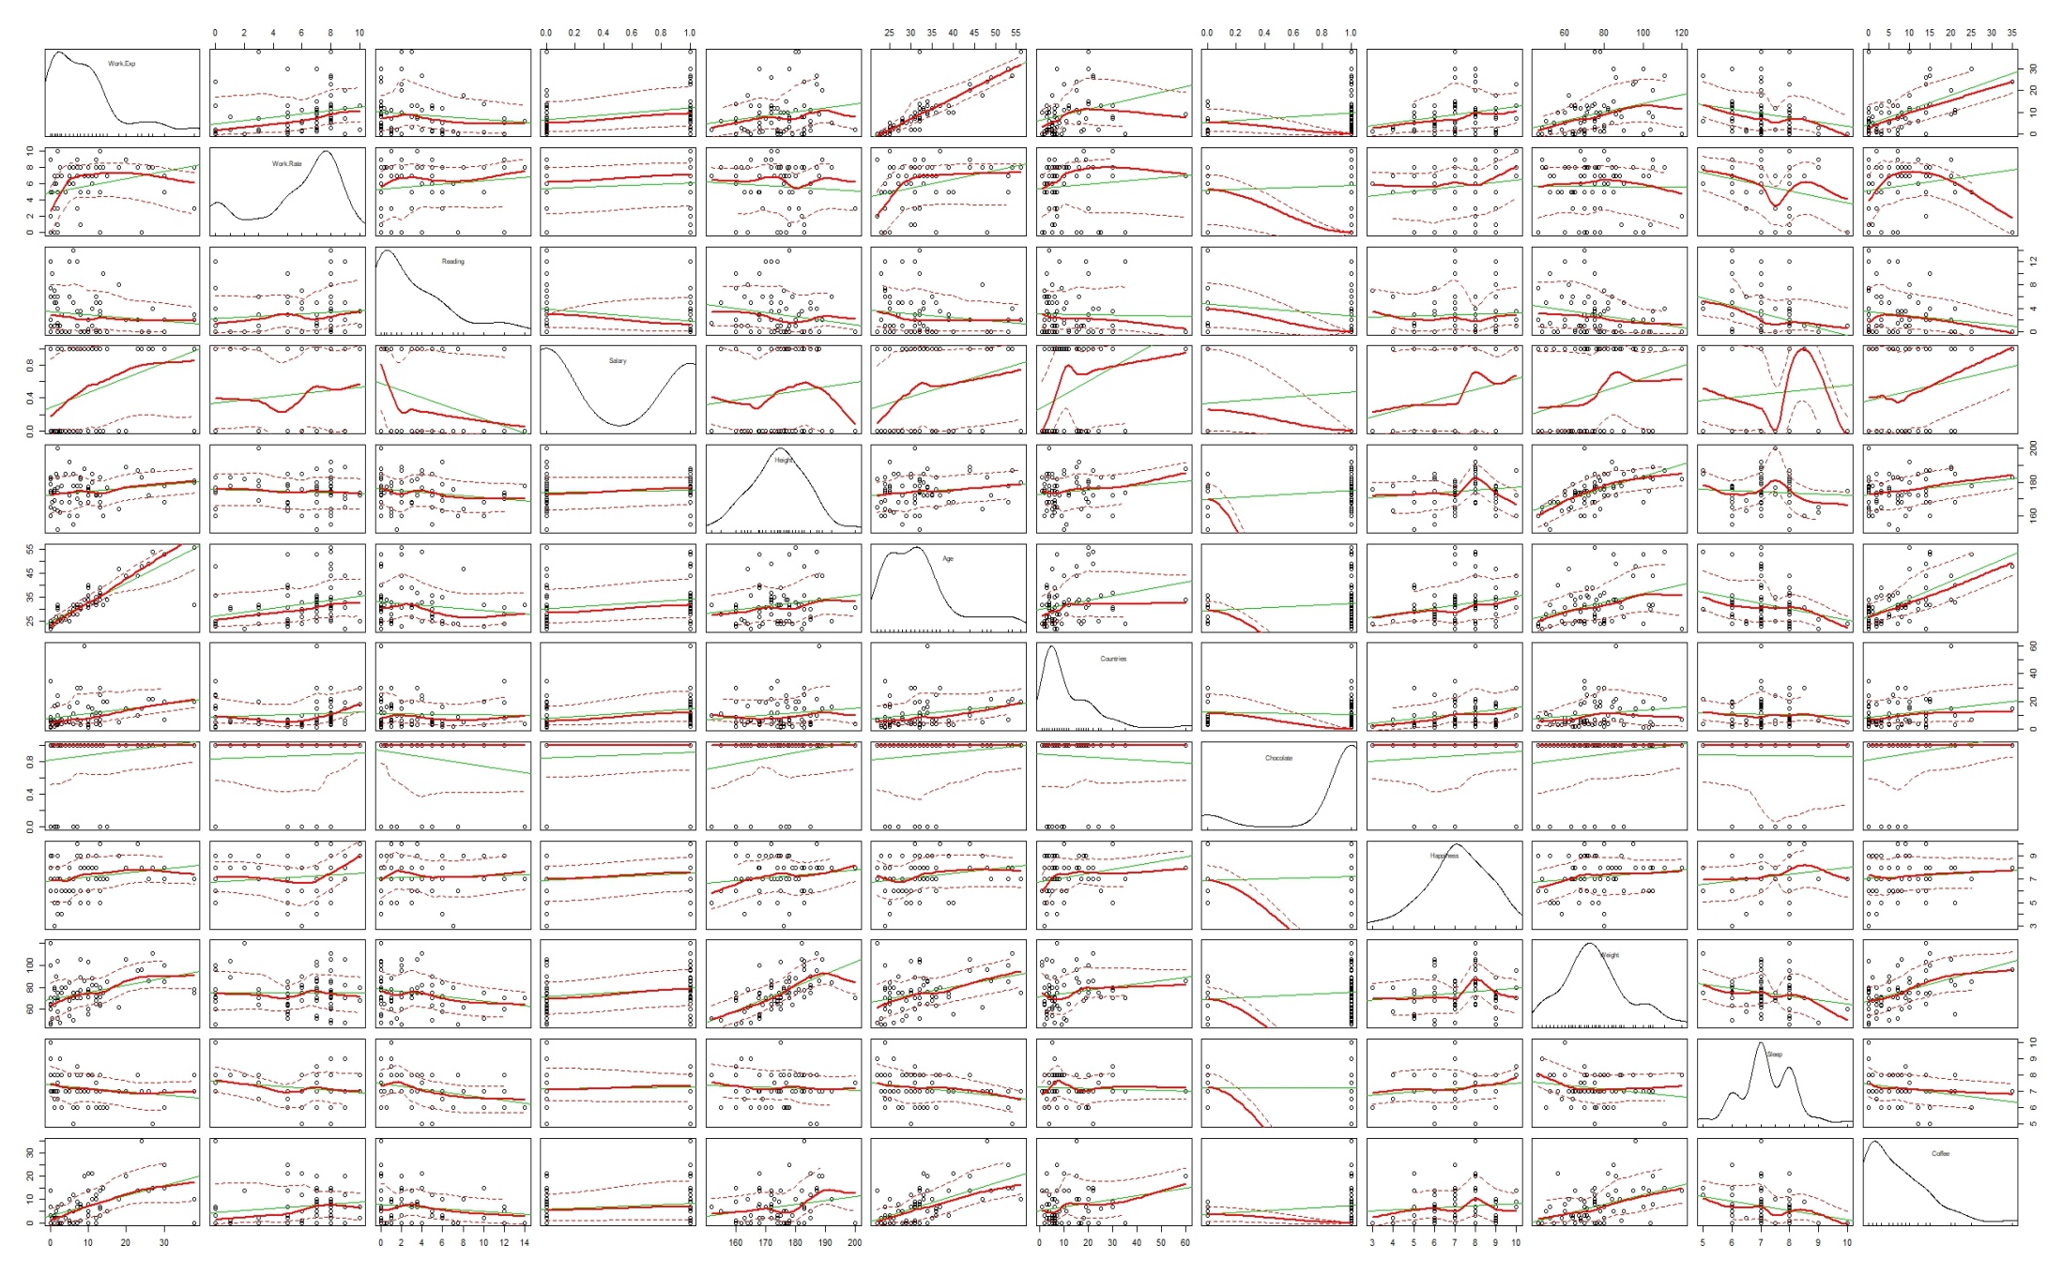
Density, Regression Line, Scatter Plot Matrix
Notes:
Estimate density fore each question with bandwidth 1
The thick red line represents smoother line, computed using loess line smoother.
The green line is the true regression line.
The red dotted lines are the standard deviation.

